Slide 1
ALTITUDE
Notes:
MH – Representing ALTITUDE - brief intro

Slide 2
In this session
Video: Summary of the Charter
Policy and Sectoral Context for Charter Development
Who was Involved in Development?
Project Development, Outputs & Aims of the Charter
What’s inside the ALTITUDE Charter?
Key Points?
Notes:
MH

Slide 3
ALTITUDE Video
Notes:
Embedded Youtube Video – be sure to turn on captions on the youtube player

Slide 4
Policy and Sectoral Context
Increasing legislative and policy responsibility for access and inclusion
Sectoral commitment ‘Inclusion is Everyone’s Business’ approach – collective responsibility.
Research showing gap at strategic level of institutions (Healy et al., 2023)
Strong early focus on UDL – need to widen the UD conversation.
Notes:
MH
Strong legislative responsibility for access and inclusion present, and with the European Accessibility Act coming down the tracks, that responsibility will grow.
Sectoral commitment ‘Inclusion is Everyone’s Business’ approach – collective responsibility. UD is an evidence-based approach to make that idea a reality.
However, Irish research shows – more dialog required at the strategic level, lack of collaborative effort between different areas of institutions evident.
Charter seeks to address this, supporting institutions to operationalise a UD approach, improving the student experience and increasing compliance with existing and impending Irish and EU law.

Slide 5
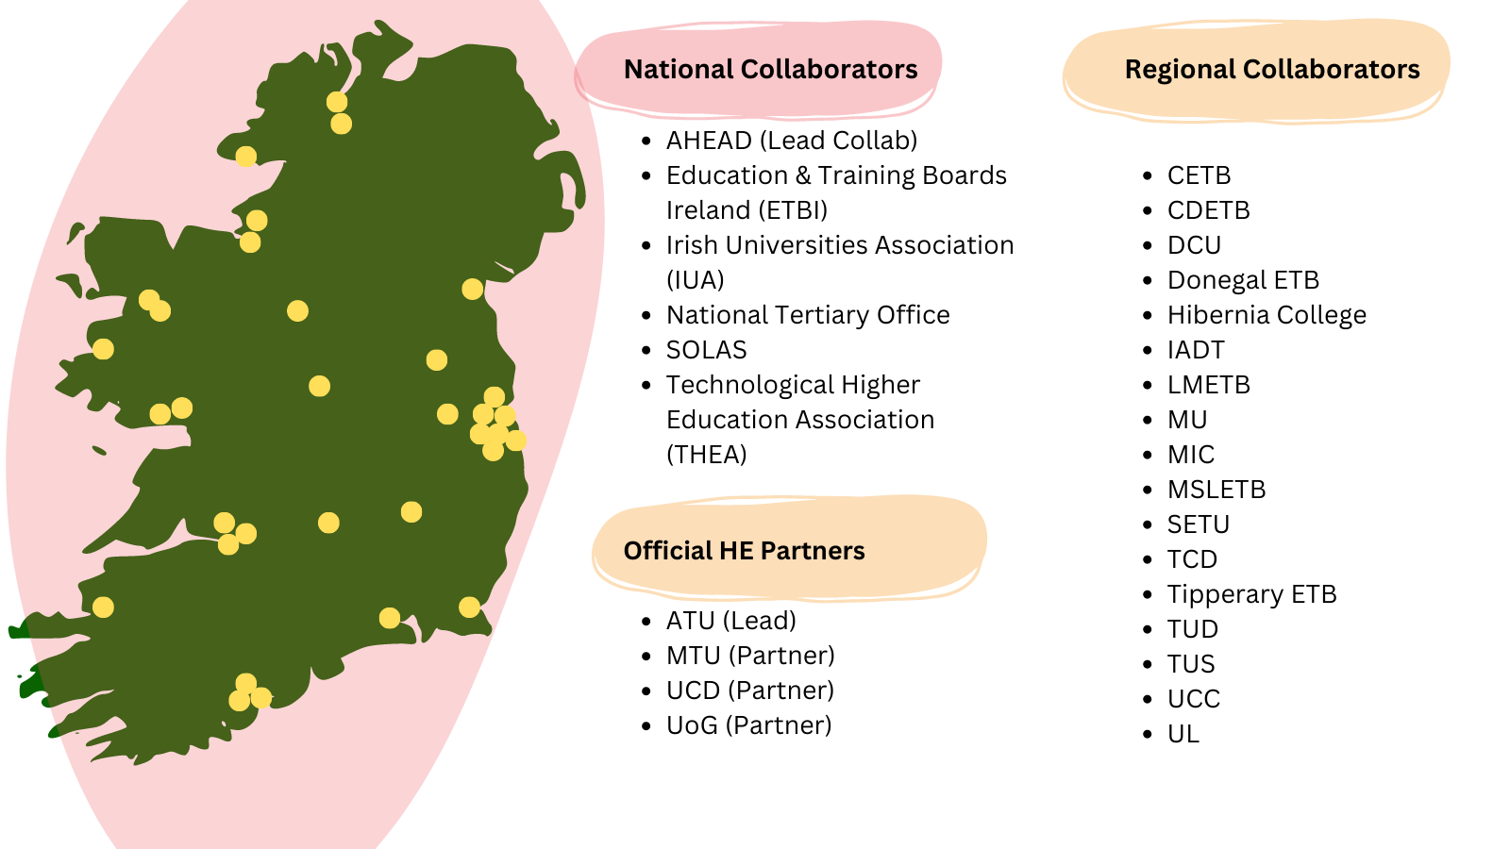
Who’s Involved?
Notes:
MH
6 ETB reps nominated by FET Directors Forum to represent the whole sector

Slide 6
Vision of the ALTITUDE Project
“Tertiary education institutions where all learners are transformatively included through universal design in education.”
Mission of the Project
“To support HEIs and ETBs to make sustainable progress towards systemically embedding a universal design approach, which places human diversity at the heart of tertiary education design and fosters student success for all.”
Notes:
MH

Slide 7
ALTITUDE - Project Outputs
ALTITUDE Charter
UNLOCKING INCLUSION TOOLKIT – Supporting Implementation
Technical Report
Notes:
Charter: The vehicle for your institution to declare its intent to make incremental and sustainable progress towards embedding a universal design approach – Embedded in this document.
Toolkit: A practical toolkit with key guidance, self-assessment tools and case study examples of good practice in action, which support the implementation of the ALTITUDE Charter.
Technical Report: (led by Dr Joanne Banks) Research report outlining the context for the development of the Charter, the evidence base that underpins it, the alignment of the Charter with legislation and policy, and recommendations on its implementation.

Slide 8
Development of the Charter
Strategic Foundations & Scaffolding
Learning, Teaching & Assessment | Supports, Services & Social Engagement | Physical Environment | Digital Environment
(Burgstahler, 2009; Kelly & Padden, 2018)
Deep Literature Review
Significant Staff & Student Consultation
Huge Cross Sectoral Collaboration
Senior Stakeholder Dialogue
Notes:
The charter has been developed and built upon:
Review of international literature
5 phases of consultation including:
National 2 day consultation event (reference last years conference)
30+ staff and learner focus groups
1200+ learner survey responses
A stakeholder dialogue process, which will continue post launch
Drawing on the literature, both internationally and nationally for example the UCD toolkit for inclusive HEIs which was updated as part of this project, the Charter looks specifically at 4 different areas on institutions where UD can be applied:
Teaching and Learning
Supports & Services
Physical Environment
Digital Environment
We call these the 4 pillars of the Charter.

Slide 9
How ALTITUDE Can Help Institutions
Vehicle to declare your Intent
Anchor a culture of shared responsibility
Strategies, policies and procedures
More Unified Language of and commitment to UD
More effective compliance
Notes:
Provide a vehicle for your institution to declare its intent to make incremental and sustainable progress towards embedding a universal design approach, in line with its resources, culture and strategy.
Promote the development and sharing of policies, structures, and strategies in your institution which support the sustainable implementation of a universal design approach.
Support a culture of shared responsibility for universal design, access & inclusion in your institution, by promoting development of organisational structures which foster an ‘everyone’s business’ approach to inclusion.
Develop a more unified language of and commitment to a universal design approach in your institution and across the tertiary sector, fostering greater opportunities for partnership, collaboration, and shared learning.
Support your institution to comply with Irish law and work towards goals in a range of key national and international strategies concerning universal design, accessibility, student success, sustainability, and inclusion.
End of slide: Important to say adoption not yet open, today is the launch of a national conversation

Slide 10
Inside the ALTITUDE Charter
Develop Strategic Enablers Over Time
Implementation
Committee/
Working Group
Advance Pillar-Based Goals and Related Actions
Learning, Teaching, & Assessment | Supports, Services & Social Engagement | Physical Environment | Digital Environment
Notes:
The Charter commits the institution to establishing a standing committee or working group structure (or adapting an existing one) to advance this goal, using the Charter as a roadmap to foster collaboration, identify opportunities for progress and guide decision-making. The makeup of the group should aim to maximise the impact of the Charter, ensuring representation of senior management, heads of key functions relating to the Charter Pillars, student representatives and UD-knowledgeable staff members. This group will oversee incremental progress to develop strategic enablers for a sustainable UD approach:
-Leaders modelling and visibly supporting UD
-Embedding UD & Accessibility in organisational strategy and policy
-Partnering with students as appropriate in the design of policy & strategy, with a focus on disadvantaged cohorts
-Promoting local and national collaboration, shared learning opportunities, and role-appropriate training in UD
-Recognising UD and inclusive practice in recruitment and promotion of staff
-Evaluating, celebrating and sharing good UD practice across the institution and nationally
The group also fosters collaboration to advance related goals in the 4 key pillars (Fig 4). Key to this effort will be using policy and strategy review cycles to embed UD at the strategic level, and to identify opportunities provided through national and local funding streams to advance goals within the pillars.

Slide 11
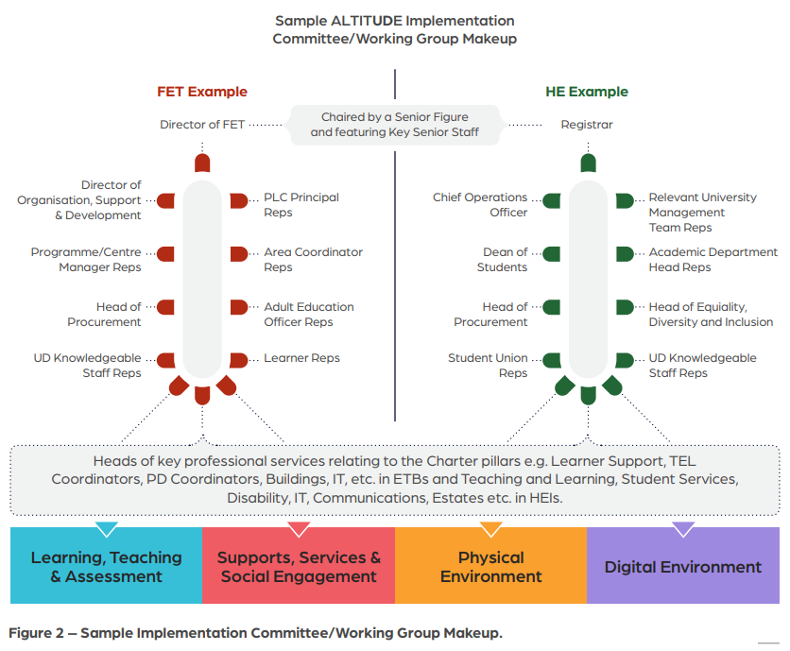
Working Group Makeup

Slide 12
Key Points
By the sector, for the sector!
Building on existing initiatives – greater coherence
Iterative transformation over time – slow and steady progress.
Not replacing existing frameworks – but strategically embedding them!
Not creating a new function – collaboration between existing key functions on UD!
Commitment to the journey, not the destination! Recognition of different stages of progress!
Notes:
DR

Slide 13
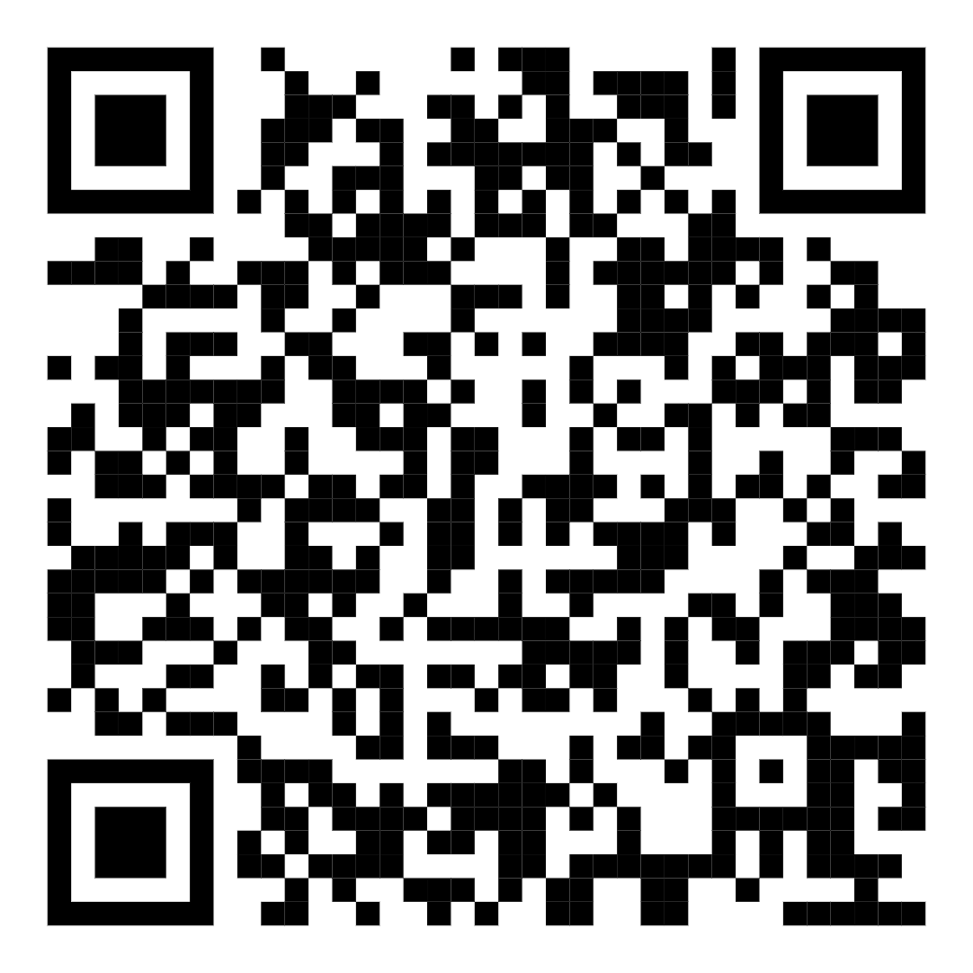
Questions?
Contact:
Go to the Project Webpage
Shareable Video on the Charter
Join the ALTITUDE Community mailing list for news and updates to your inbox:
Notes:
Express your interest in joining the ALTITUDE Community: https://forms.office.com/Pages/ResponsePage.aspx?id=uGz8vUI7OkCU3U7z2zMPG1a4S8AdnApBjv58C15VqzBUREM1N0tXWEo1OFM0VTQ1MUxYOFdINkdIMy4u

